Slide 1
In the last ETL tutorial (ETL Quality)
You identified reports
You created a star schema for the reports
You used data sets (prefixed at S0_)
These represented the first set of staging area tables
You created a data dictionary (based on the data source) to address the data quality of the original data sources
You cleaned the data and created a clean data set S_1_DataSet1

Slide 2
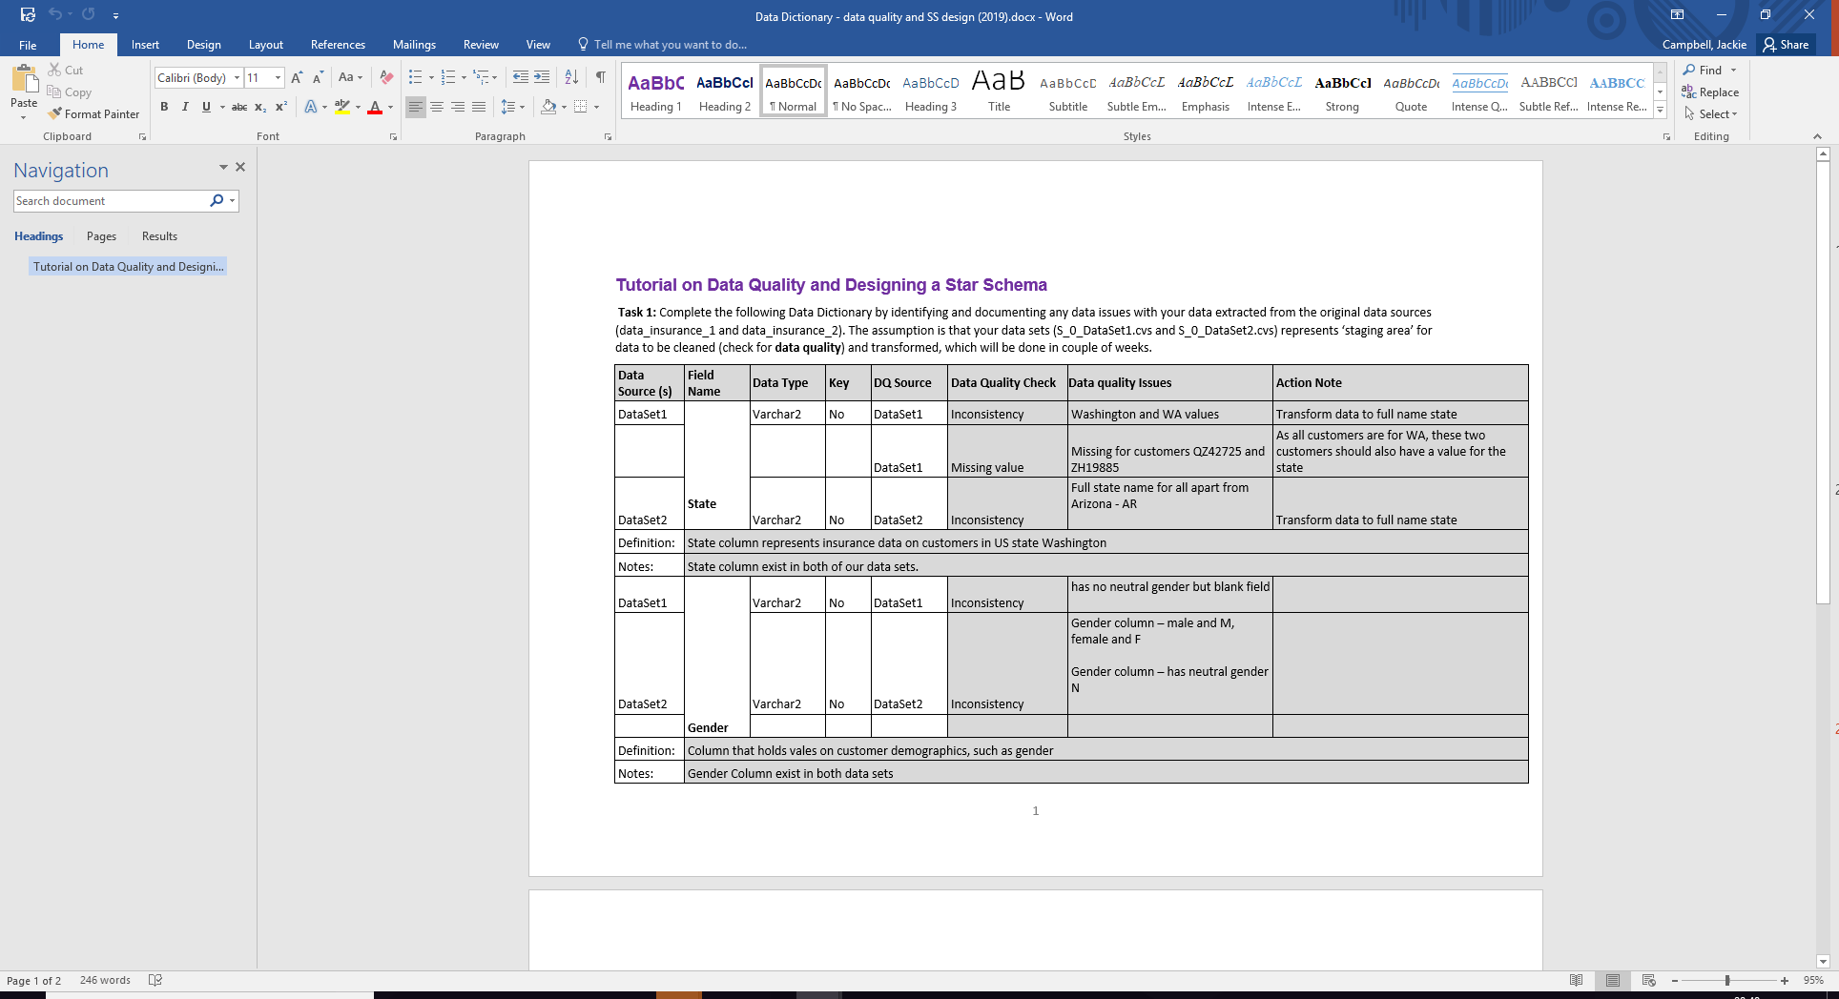

Slide 3
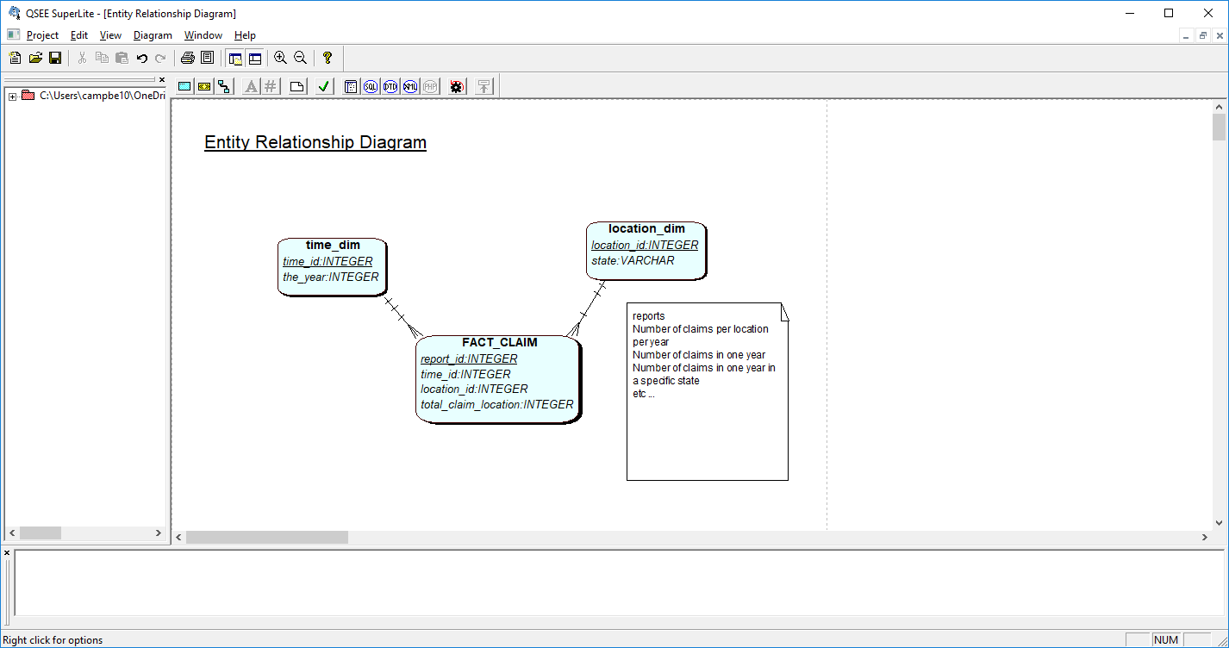
Solution

Slide 4
In this tutorial ETL tutorial (ETL Transform and load)
We will create a data dictionary for the star schema model (data mart) using the Data Dictionary 2 template
Transformations may include:
Creating measures
Defining standards
Extra dimensions (eg salary band – high, medium, low)
Calculations, aggregations
Adding metadata
New attributes eg event
Dimension data, surrogate keys

Slide 5
In this tutorial ETL tutorial (ETL Transform and load)
Load
When the transformations are complete and created via staging tables S1_ … S??_ ….
The data can be loaded from the staging tables into the fact and dimension tables (using SQL or load tools)
Note that the data dictionary (Data_Dictionary2) effectively provides the design and structure to the ETL script.

Slide 6
